Slide 1

Sales Prediction Case Project
Analyze the impact of advertising expenditures across TV, Radio, and Newspapers on product sales to optimize marketing strategies.
A case study carried out by Aryan Singhal

Slide 2

OUTLINE
Introduction
Data cleaning
Key visualizations
Linear Regression

Slide 3
Introduction
Summary of Dataset
Column Descriptions
The dataset provides information on advertising expenditures across TV, Radio, and Newspapers, along with the corresponding product sales. It allows analysis of how spending in these areas impacts sales, making it useful for predictive modelling and understanding the effectiveness of different advertising strategies.
Campaign: Identifier for each advertising campaign.
TV: Spend on TV advertising.
Radio: Spend on Radio advertising.
Newspaper: Spend on Newspaper advertising.
Sales: Units sold related to the ad spend.

Slide 4

Data cleaning
Resolving issues of messy and dirty data

Slide 5
Issues with Dataset
Dirty Data
Messy Data
Missing Values
NOT APPLICABLE

Slide 6
Key visualizations
Visualizations from the dataset

Slide 7
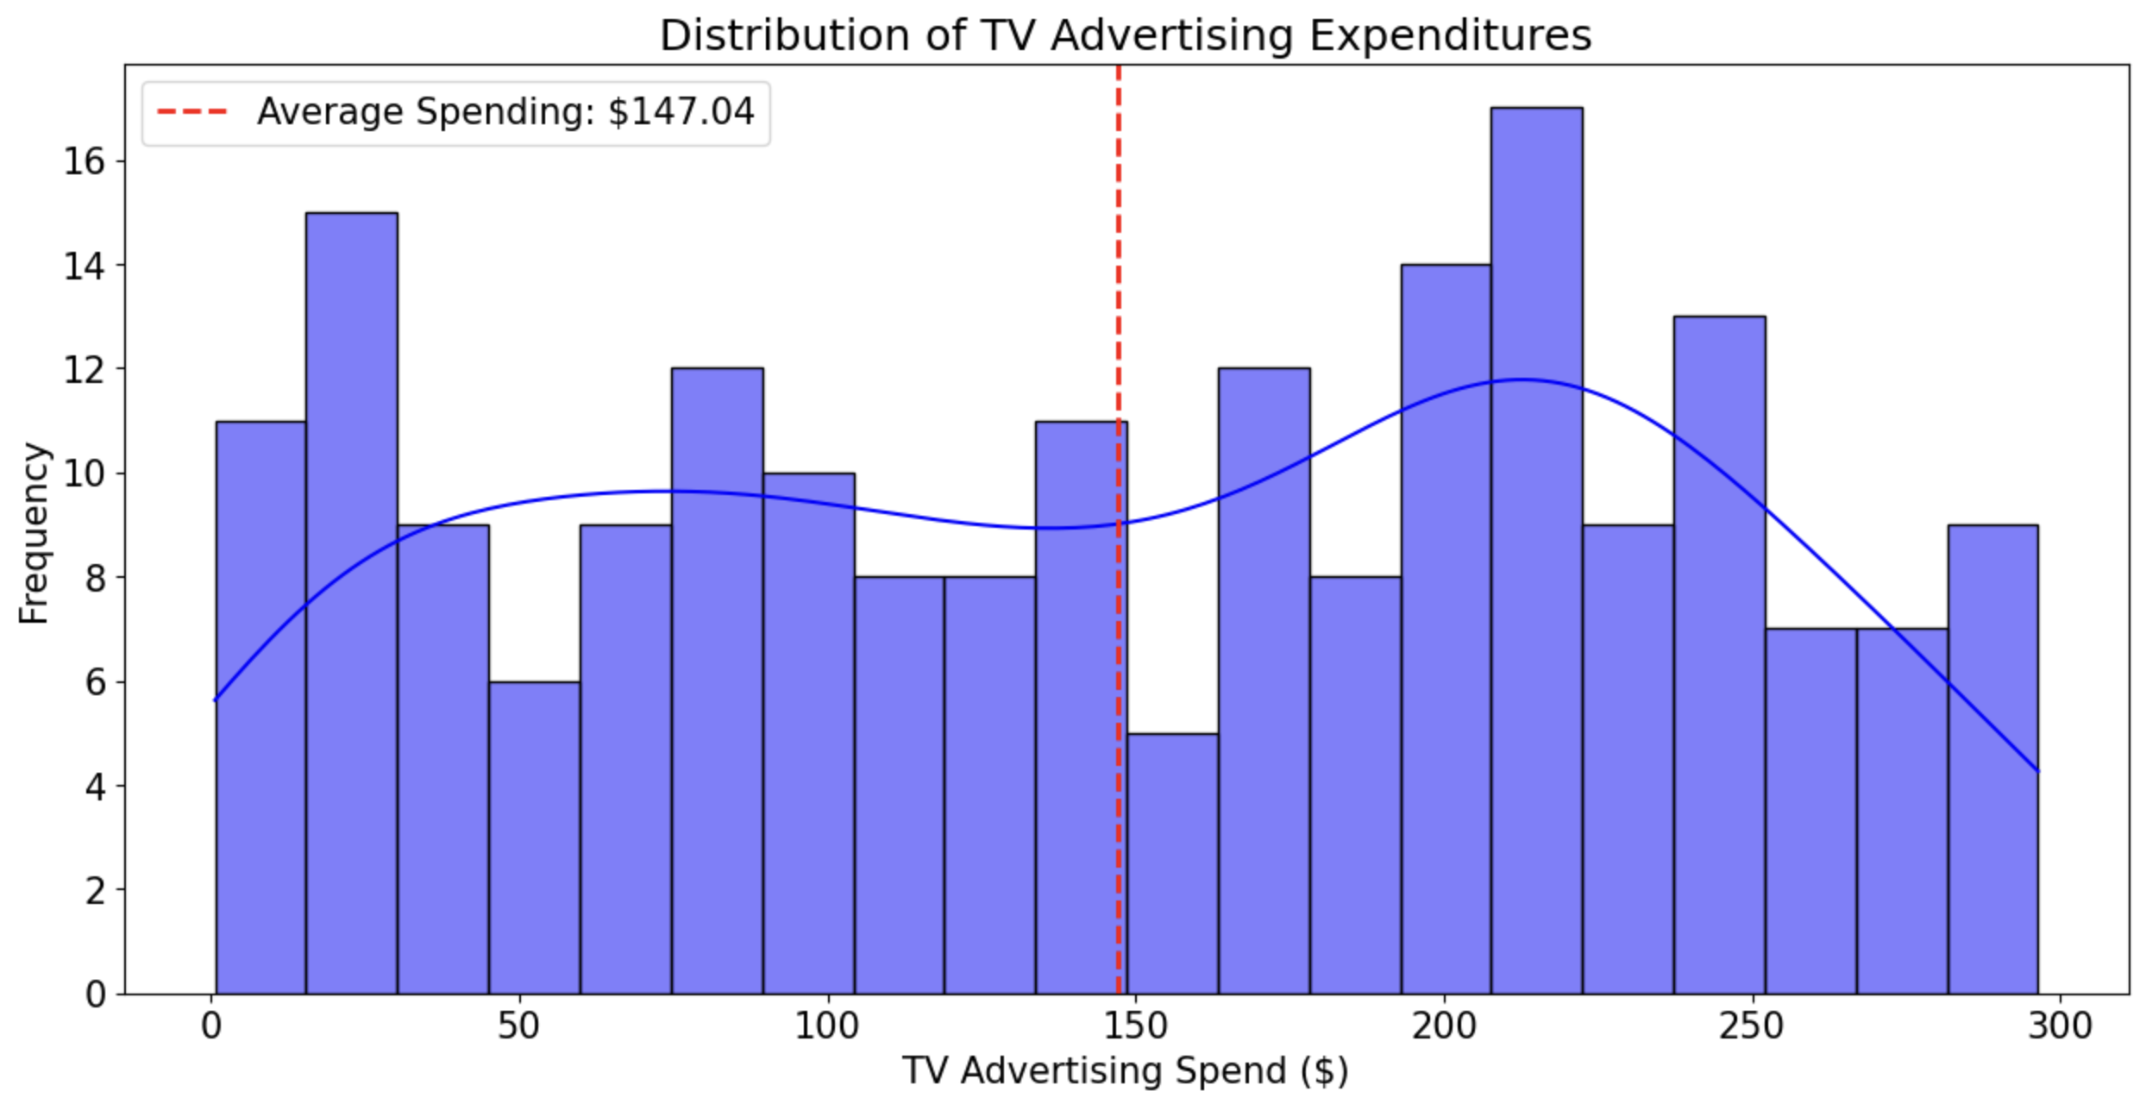
Chart 1: Avg. Spending on Tv ads
TV advertising expenditures are widely distributed around an average of $147, indicating varied spending strategies.

Slide 8
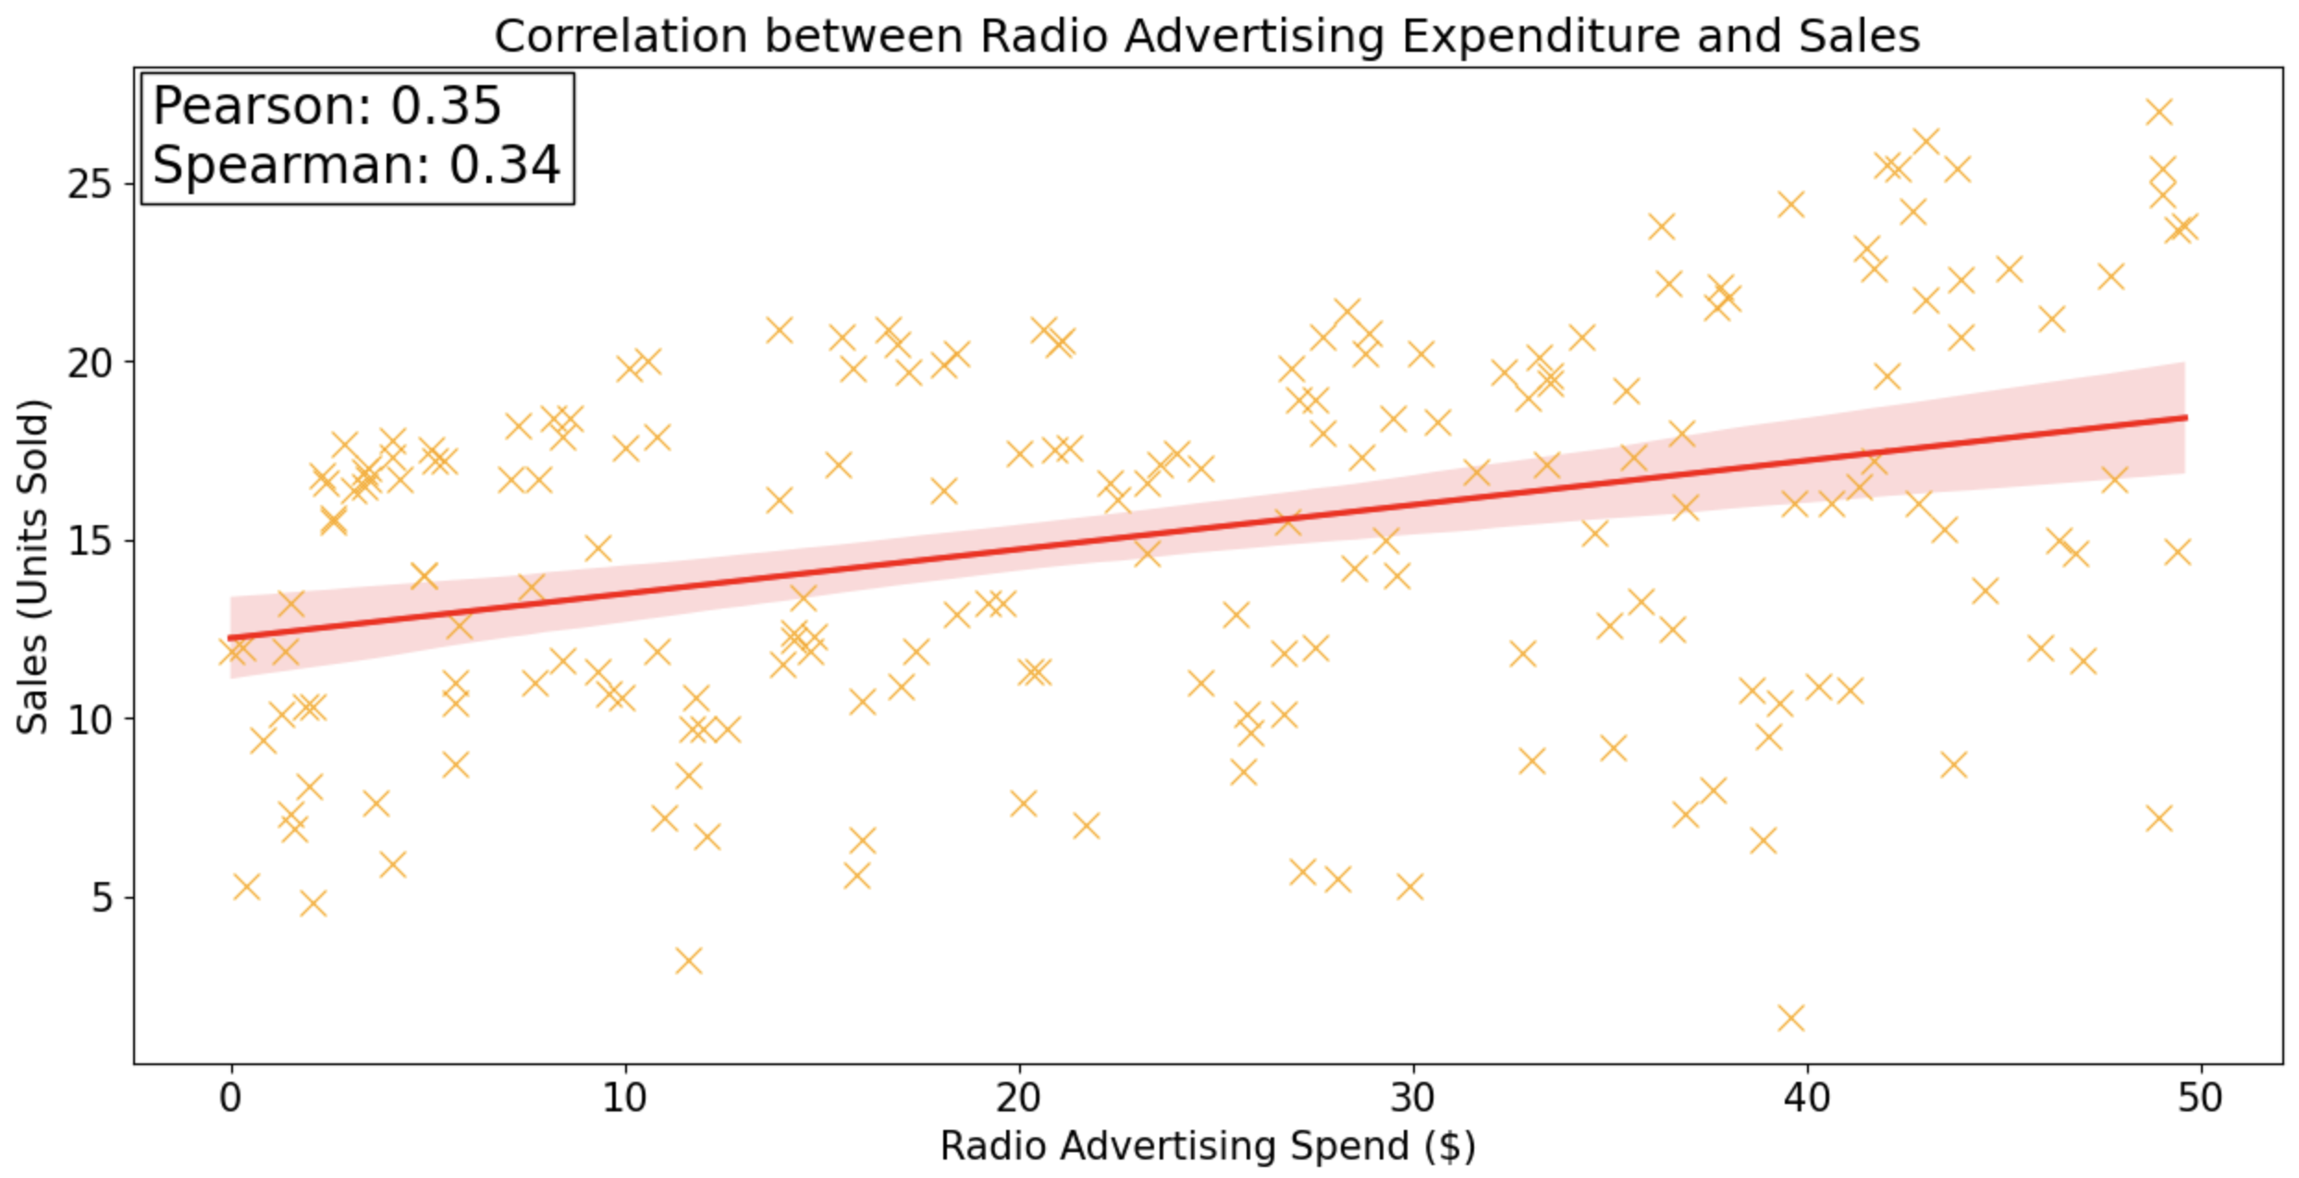
Chart 2: Radio-ads vs Sales
Radio advertising expenditure has a weak positive correlation with sales (Pearson: 0.35, Spearman: 0.34), indicating a limited impact.

Slide 9
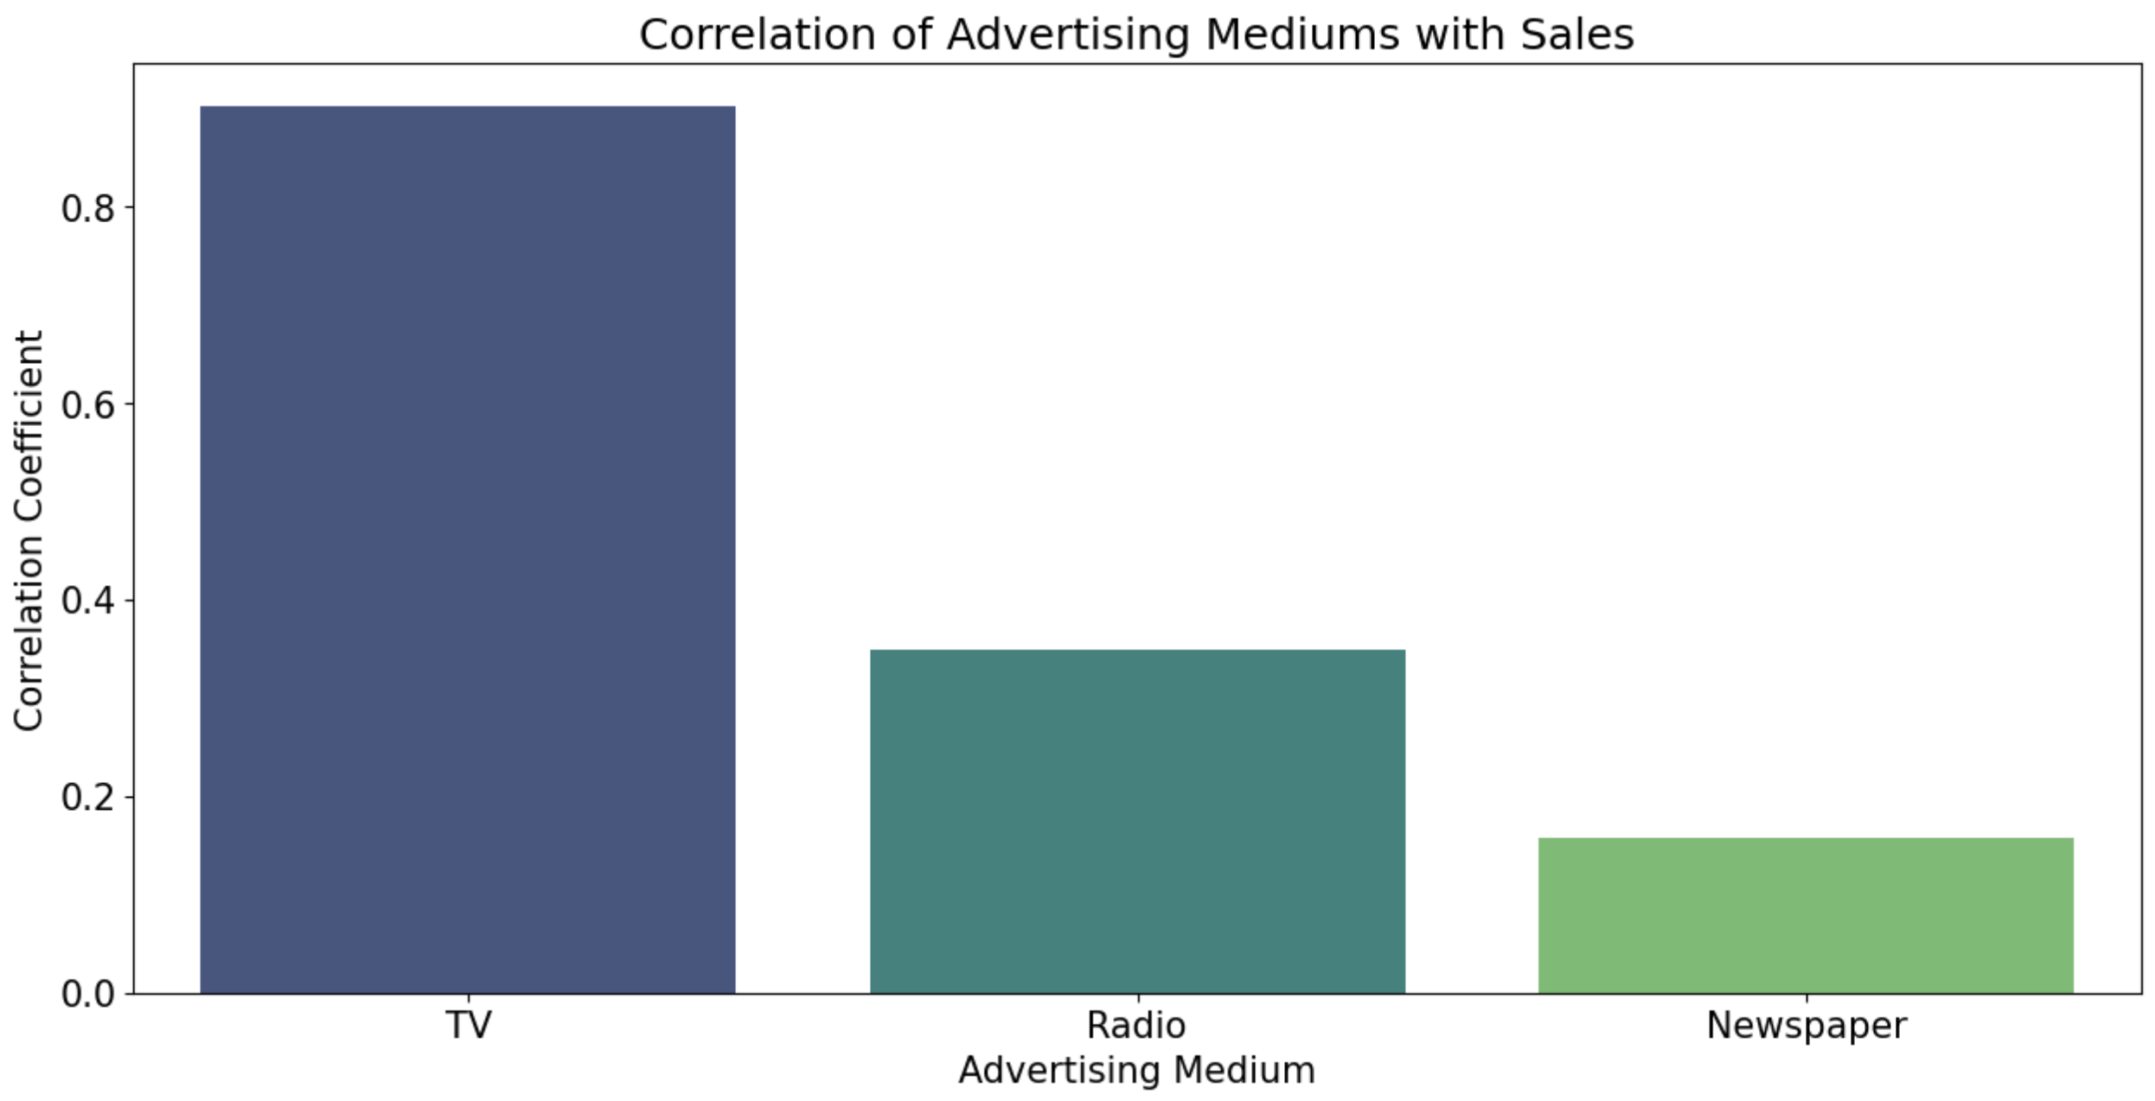
Chart 3: Sales vs Advertising mediums
TV advertising has the highest correlation with sales, while Radio and Newspaper have much weaker correlations.

Slide 10

Linear Regression

Slide 11
Workflow
Train-Test Split
Fit Linear Regression Model
Normalize the data and re-fit the model
Leaving out TV as a predictor to reflect its significance

Slide 12
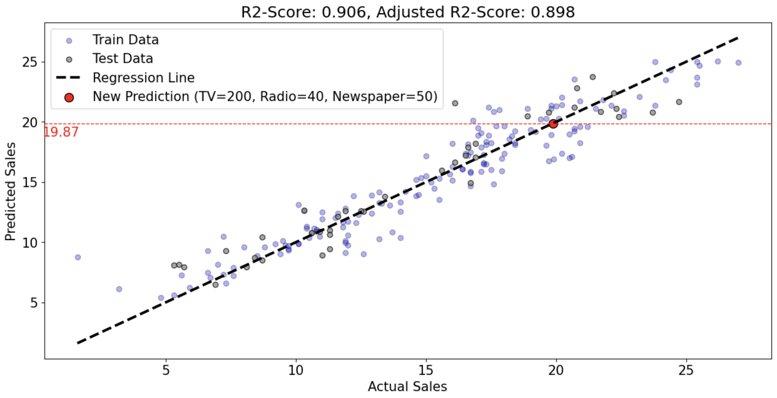
Linear Regression
Prediction on a new Data Point

Slide 13
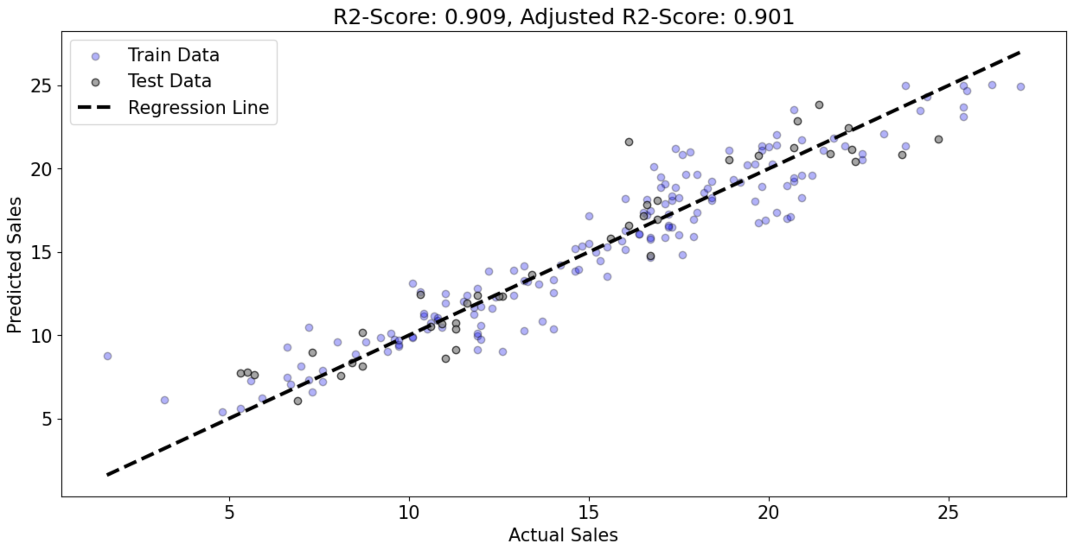
Linear Regression after Normalization
Normalization slightly improves the R² score (0.909 vs. 0.906) by aligning feature scales.

Slide 14
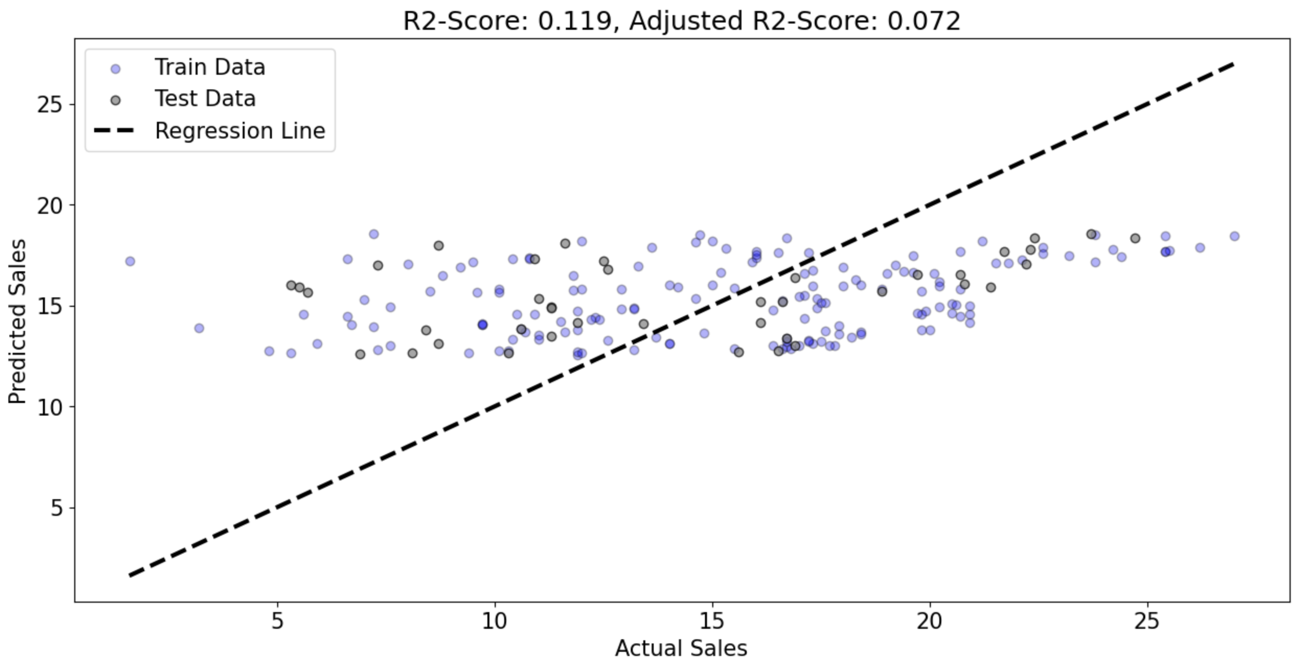
Linear Regression Leaving out TV
Excluding TV drops the R² to 0.119, showing its critical role in predicting sales.

Slide 15
THANK YOU!

